Slide 1
Big 4:
Tan Yiqin
Cui Simeng
Li Xiaotong
Chen Qiman
JOUR 7280/COMM 7780
Big Data in Media
2018/04/27
Fast food fights

Slide 2

C O N T E N T S
01
Potencial Chinese-style fast food
-- why we choose the topic
02
Ratings may tell
--our access to the story
Review and future work
03
Data analysis Insights
--Things in common
--Café De Coral jumps out
--Hints from Café De Coral
04

Slide 3
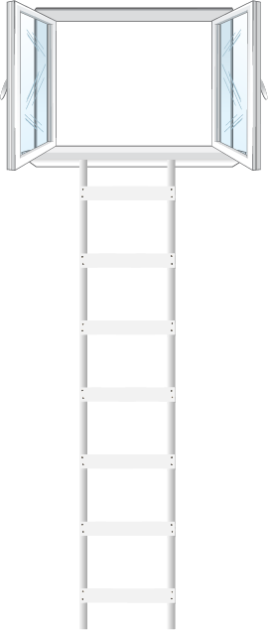
Potencial Chinese-style fast food
01
Average annual growth rate of 18%;
The fast food segment accounted for 20.8% of total catering industry revenue in 2016;
Forecasts an RMB 1 trillion sales revenue in fast food industry in 2021.
02
The proportion of fast food in catering industry :
35% in U.S
30% in Europe
20% in Japan
5% in China’s first-tier cities
03
Western and Chinese-style fast food restaurant proportion:
10% vs 90%
Fluctuation of market share of McDonal’s and KFC:
57% →37.7%

Slide 4
What do the fast food giants
MISS ?

Slide 5
Ratings May Tell
Source:
Dianping.com
in Shenzhen
What we scrape
Tastes
Environments
Services
Per capita consumption price
Comment-volumes
Levels of the customers
Why we scrape:
May give us some consumer insights
about fast food industry in Shenzhen
Who we choose
McDonald’s
KFC
Kungfu Restaurant
Wallace
Café De Coral

Slide 6
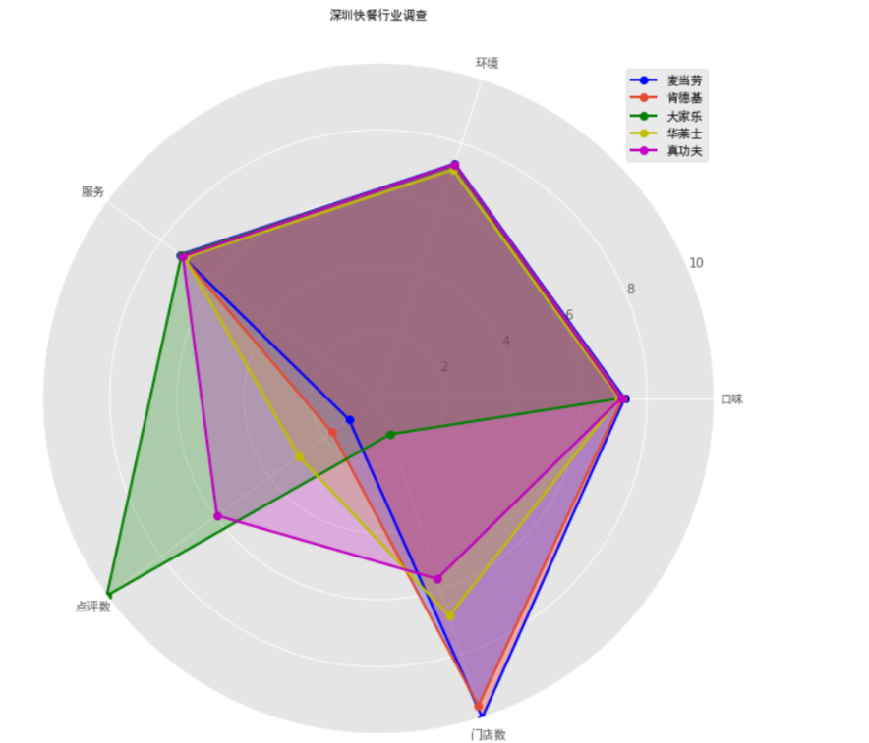
Ratings May tell
Radar Chart to Show the Industry
ADD YOUR TEXT
Monopolustic Competition
Amet adipiscing elit, sed diam nonummy nibh euismod tincidunt ut laoreet dolore magna
“Characterizes an industry in which many firms offer products or services that are similar, but not totally identical or perfect substitutes.” - Investopedia
ADD YOUR TEXT
Amet adipiscing elit, sed diam nonummy nibh euismod tincidunt ut laoreet dolore magna

Slide 7
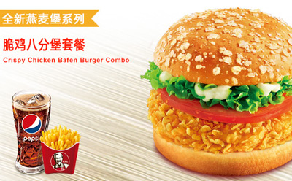
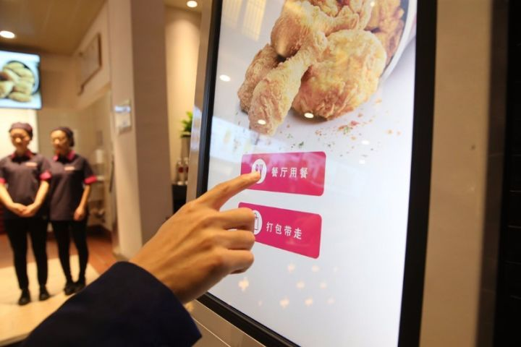
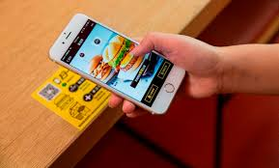
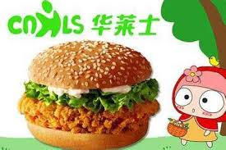
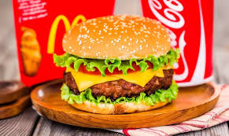
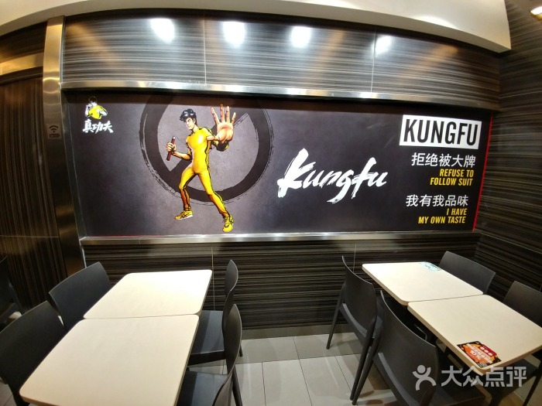
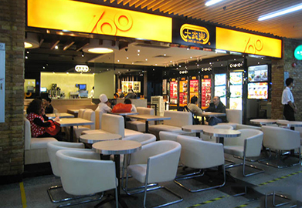
Analyse Insights
Things are in common
Food Flavor
Standardized food products
Service
Combine staff service with mobile ordering, have online delivery food service, and establish central food process and logistic center
Restaurant Environment
Well-decorated to suit for fast and comfortable dining styles

Slide 8
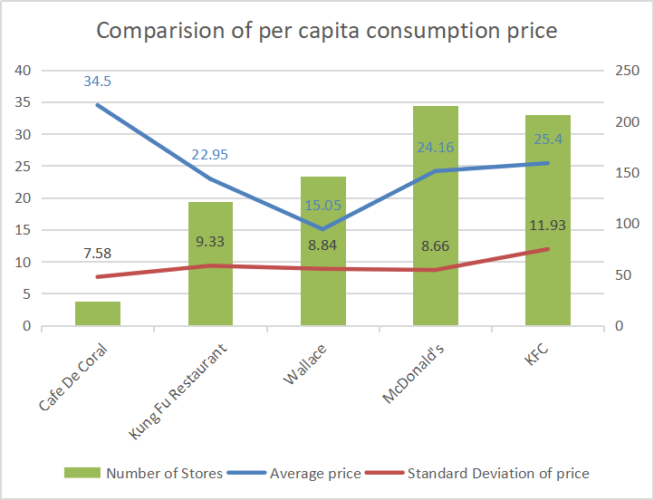
Analyse Insights
Café De Coral Jumps Out
KEY
WORDS
Price is the highest
Consumers are still willing to afford more expensive food in Cafe De Coral
KEY
WORDS
KEY
WORDS
SD level is flat
KEY
WORDS
KEY
WORDS
KEY
WORDS
From the consumer insight, consumer’s willingness to afford the prices in different restaurants of five brands is similar
Differentiated strategies
Providing quality dishes and creating new dish choices by Cafe De Coral to explain the attractiveness

Slide 9
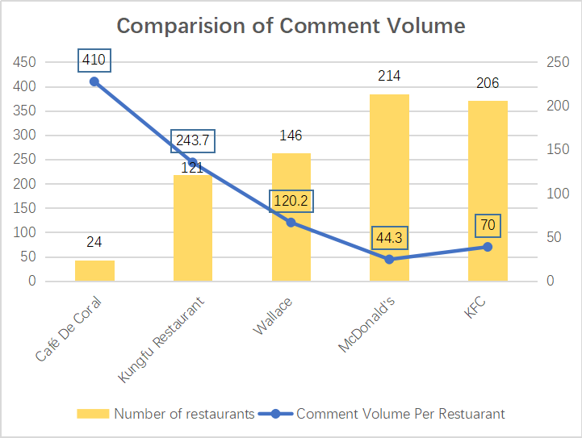
Analyse Insights
Café De Coral Jumps Out
KEY
WORDS
Huge volume of comments
It is uncommon as target consumers of fast food are always in pursue of convenience and shorter meal time.
KEY
WORDS
KEY
WORDS
KEY
WORDS
KEY
WORDS
KEY
WORDS

Slide 10

What Can We Vertify or Find Through Outperformance of Comments?
Hints from Café De Coral

Slide 11
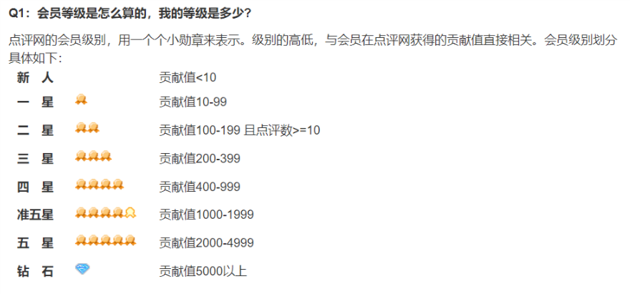
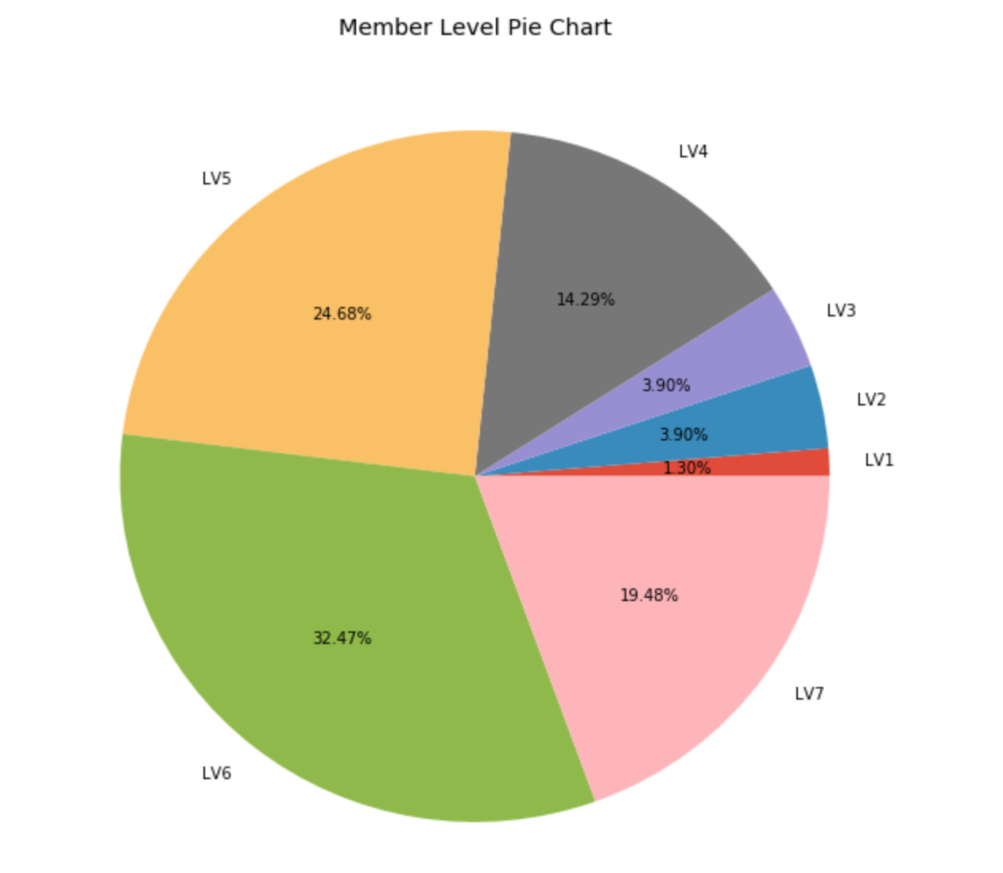
Data Analyse
Hints from Café De Coral
KEY
WORDS
KEY
WORDS
KEY
WORDS
(Source: Dianping.com)
KEY
WORDS
KEY
WORDS
KEY
WORDS
Authentic customers
Normally, the fake accounts are at lower user levels.
Most of the Café De Coral customers are above level three, above LV 3 is active users.

Slide 12
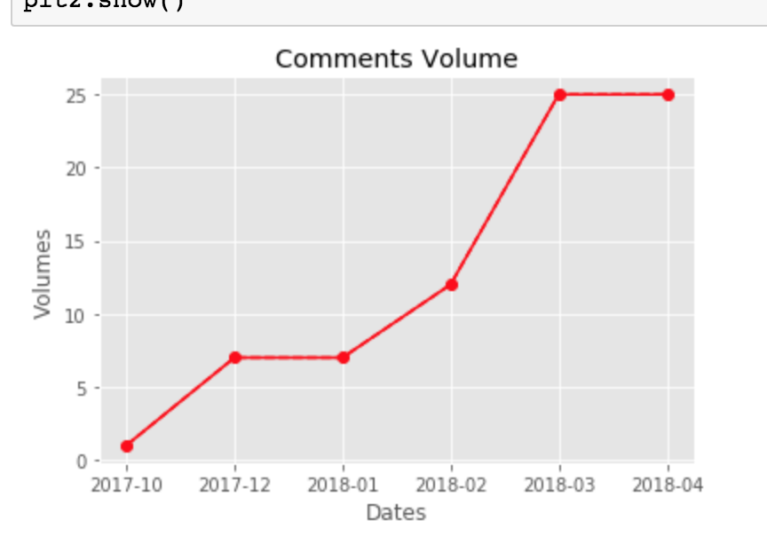
Data Analyse
Hints from Café De Coral
An outburst of comments in 2018
Adding “Dates” and “volume” as two variables, we can find out there is an outburst of comments volume per restaurant per month in 2018.

Slide 13
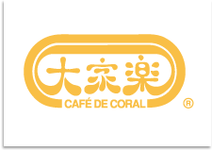
Possible reasons behind
--Answers from 2017 annual report
6% increase of revenue in South mainland China
01
Revamp of menu
Customers’ choices are regularly enhanced with seasonal ingredients and recipes for quality lifestyle and leisure dining.
02
New customer relationship management program
Café De Coral launched the “Happiness First” brand campaign; a large-scale customer Journey program to generate a high level of brand awareness
03
New business model
E-commerce and O2O (online to offline) deliveries in response to consumption behavior.

Slide 14
Data Analyze
Hints from Café De Coral
High frequency words
KEY
WORDS
“Cafe De Coral”
“Pork Steak”
“Milk tea”
“Afternoon tea”
……
KEY
WORDS
KEY
WORDS
KEY
WORDS
KEY
WORDS
KEY
WORDS
Top keywords help bind Hong Kong style with this brand.
Positioned itself as a "middle-class” catering service from Hong Kong in mainland.

Slide 15
Overview of Cafe De Coral
Faster response to the change of
customer behavior
-- New Module of Business - O2O
01
02
Differentiated Strategies
-- Brand building
Hints from Café De Coral

Slide 16
Future work
01
Enlarge database
-- Adding more brands
-- Combining more cities
-- Scraping more websites
02
More creative
-- Using multiple ways to tell a story
-- Going deeper to analyse data
Hints from Café De Coral

Slide 17

THANK YOU

